Slide 1

Identify root components of website below

Slide 2

Root div
- Height: 100vh
content
nav
Flex: 0
header
Flex: 0
Flex: 1

Slide 3
Identifying Navigation-Bar
display: flex;
Flex-direction: row;
justify-content: space-between;
Navigation
Title
Menu-Bar
Tool
Display: flex
Flex-direction: row;
Justify-content: center
Align-items: center;
Display: flex
Flex-direction: row;
Justify-content: center
Align-items: center;
Display: flex
Flex-direction: row;
Justify-content: center
Align-items: center;
Navigation-Bar is divided into 3 parts; Platform title, Menu-Bar, Tools. Each part are displayed in flexbox, justified and aligned at the center.

Slide 4
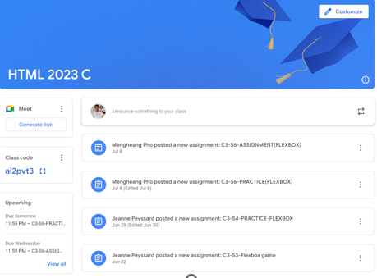
Identifying Content
Flex-grow: 2
Header/Content title
Side-Bar
Main-Content
Flex-grow: 0
Flex-grow: 1

Slide 5
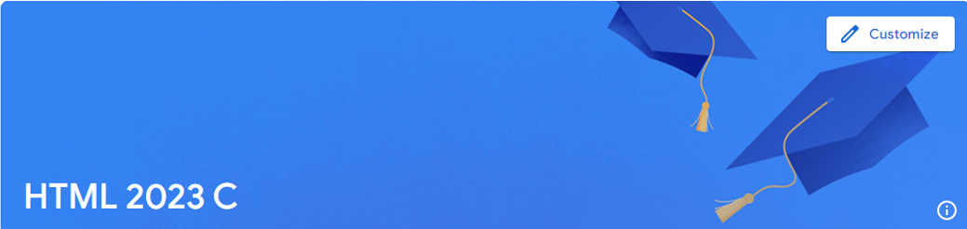
Identifying Content - Header
Display: flex
Flex-direction: row
Flex-grow: 2
Button
Title
Header is divided into 2 parts; title, button and is displayed in row. Each part are self aligned and justified to arrange its position.
Title
Button
Align-self: flex-end;
Justify-self: flex-start;
Align-self: flex-start;
Justify-self: flex-end;

Slide 6
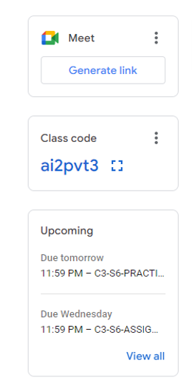
Identifying Content - SideBar
Logo
Meeting Creation
Button
Title
Display: flex;
Flex-direction: column
Class Code
Code
Date
Schedule
Detail/Description
Flex-grow: 0;

Slide 7
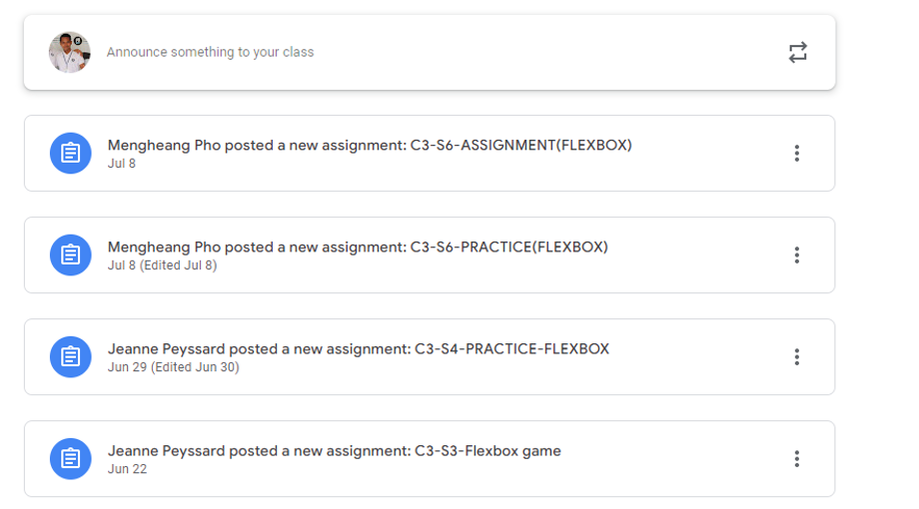
Identifying Content - MainContent
Display: flex;
Flex-direction: column
Flex-grow: 1;

Slide 8
Identifying Content - MainContent
Button
Align-self: center
Justify-self: flex-end;
Content-tile
Align-self: center
Justify-self: flex-start;
In main content is divided into 2 part; post-content, posted-content. Both parts come with same format and structure. (Content-Title and Button)

